Slide 1
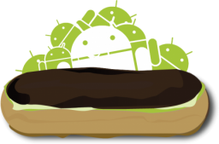
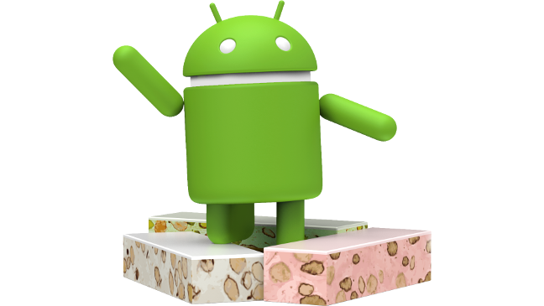
Android Evolution
2009 - 2018
Android enterprise
Device Administrator support
Ice Cream
Sandwich
Cupcake
Eclair
Gingerbread
KitKat
Marshmallow
Oreo
Donut
Froyo
Honeycomb
Jelly Bean
Lollipop
Nougat
Pie
Enterprise Mobility documentation by

